Slide 1
Challenging our Default: Pushing the Reset on Education
February 21, 2022
8:30 a.m. - 12:00 p.m.

Slide 2
Welcome
Introductions
Please sign in using the LINK in the chat
Housekeeping
Link to slides
Link to agenda
Navigating Zoom
  Video Controls
  Microphone
  Chat
  Breakout Rooms
Notes:
Agenda: https://drive.google.com/file/d/1l-NBZCA7Efx8TjdeiKzKuoZpTaZkPTfY/view?usp=sharing

Slide 3
Panel
Deana Jones: Employee Relations Manager, Wahl Clipper
Eric Lasky: Asst Principal Ridgewood HS
Heather Penczak: Director of Innovation & Implementation, EdSystems
Melvin Harrison: Director for Academic Affairs, ICCB
Erica Thieman: Director of K-12 Curricuum & Instruction, ISBE

Slide 4
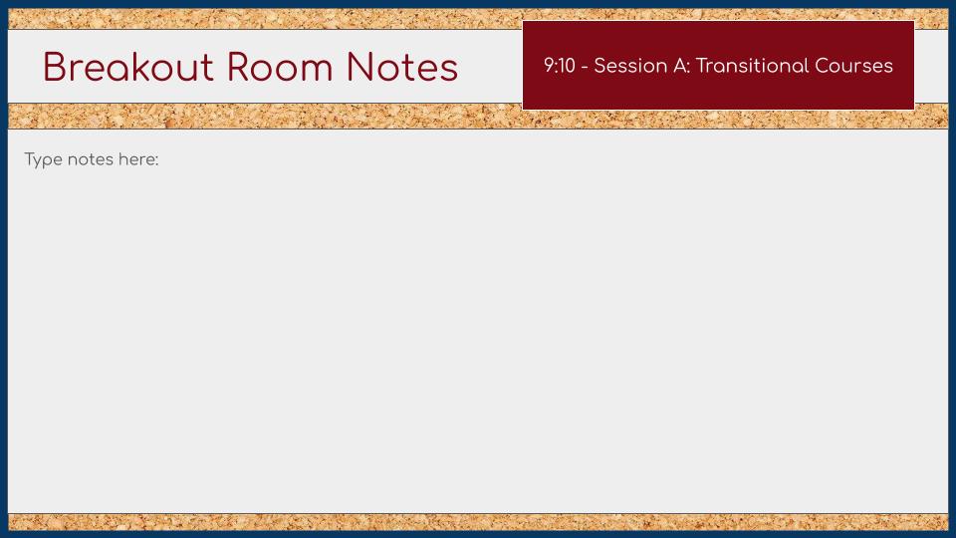
Reflecting on Panel Discussion
9:20 - 9:45 a.m.
Gail Wright
Agreed with Deana at
Wahl Clipper everything is an emergency and social-emotional
Career Education has to start in Middle School, making school meaningful and why are we here, add relevance to why in school
More experiences the better in Middle School to find out what they do or don’t like to do
Spend more time with the Junior High School Students, having the vision is important
Locally STEM Feast career opportunities (FALL, October) Middle School intro to engineering, nursing, etc. and is fun
WACC Tour, MIT in Morrison 7th grade intro program
Opportunity to look at careers
Union Expo in Rockford (19 Unions) Opportunities, but can’t take eadvantage of them
Businesses need to communicdate better with schools
Clearinghouse of ideas cocntactss for businesses
SVCC - Mfg Day in October, specialization of tour - Coordinated effort for WACC and SVCC Tour on same day
Fitting into class schedules Career Exploration and changes in what post secondary feels is important, Career Tech Ed now becoming acceptable as credit
HOME

Slide 5
Reflecting on Panel Discussion
9:20 - 9:45 a.m.
Stacey Dinges
Using the comments from Wahl Clippers - into the classroom
How do we ‘break the wheel’ ? Decisions made locally, how do we implement without going through all the ‘hoops’
Trust us educators ; let us innovate!
Create a list of the ‘myths’ ; how do we give them ‘bread crumbs’ to a career
exposure to career exploration at an early age - parental involvement is KEY
Need more funding, more staff…contradiction in giving staff more responsibility
Only so many tries to ‘do-over’...eventually have to show mastery
Adults in students lives need to be more flexible in dealing with students; coping skills, given the opportunity for a second chance
SOFT SKILLS !
HOME

Slide 6
Reflecting on Panel Discussion
9:20 - 9:45 a.m.
Chanda McDonnell
Policicie like late work
Meet the students where they are, sometimes late work is needed
double edge sword
Talk to students
perception data very helpful
communication: freshman course to introduce soft skills, do we need a senior course to teach soft skills as well,
we as professionals need to be open to communication, purposeful communication, 2-way street, outreach
open-ended question where there is no right or wrong answer
HOME

Slide 7
Reflecting on Panel Discussion
9:20 - 9:45 a.m.
Heather Waninger
Students are given task after task but are never really given the chance to be independent or try to be responsible to succeed or fail.
We have to give students responsibility?
behavior plate vs academic plate. How can I learn what they know even if they don’t turn things in on time
Students don’t have knowledge or don’t have the behavior component .
How do you communicate with parents they have the academic knowledge but maybe not soft skills or the other way around.
How do we report information about knowledge vs. soft skills to employers and higher education
How do we teach students to read to learn from textbooks or information found online. Expectations for students to learn from text or online information but do they really know they can do that? How are we using
HOME

Slide 8
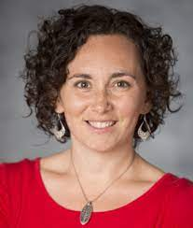

College & Career Readiness
Summit Keynote
College & Career Readiness Summit February 21, 2022
Stephanie Malia Krauss is the author of Making It: What Today’s Kids Need for Tomorrow’s World as well as the founder + principal of First Quarter Strategies. She serves as a senior advisor to Jobs for the Future (JFF), senior fellow with the CERES Institute for Children and Youth at Boston University, senior fellow with Education Northwest, and staff consultant to the Youth Transition Funders Group (YTFG). Stephanie works nationally on issues of youth readiness, child well-being, and the future of work and learning. Through her work and writing, Stephanie is relentlessly focused on what young people need to be ready for the world, and what the world needs to be ready for them.
Notes:
Link to Speaker Bio: https://drive.google.com/file/d/1l-NBZCA7Efx8TjdeiKzKuoZpTaZkPTfY/view?usp=sharing
Link to speaker powerpoint: https://docs.google.com/presentation/d/1lb1Z6PacUw2LzQtm10PZEVxRzBg6pQH2/edit?usp=sharing&ouid=108060634274125980151&rtpof=true&sd=true

Slide 9
Reflecting on the 4 Currencies:
COMPETENCIES
10:50 - 11:20 a.m.
Facilitator: Chanda McDonnell
Change our paradigm for preparation (how we prepare the students and what are we preparing them for)
Change our trajections
change our thinking about preparing for a career that we will stay in for 40 plus years
Start early possibly 5th grade for exposure and connections
make the competencies a talking point with students to teach them the terminology to have the words to describe the way they feel
Transferable skills versus soft skills
how do we fit them in
students need real life experiences in school
HOME

Slide 10
Reflecting on the 4 Currencies:
CONNECTIONS
10:50 - 11:20 a.m.
Facilitator: Gail Wright
Communication struggle with for this generation
Leasrning how to communicate better Small talk, basic communicating
Practice small talk connections with students
Why it is important to make friends, answering the phone skills, communicating to foster connections
Speech class
Resumes and who will speak on your behalf for a job
Student who is going through finding out about the person (Secret Service)
Chat time at beginning of class, interpersonal skills better without devices
Use slides we have today to go over with students, what skills do we have, what don’t we have
MS need career pathway class special to find time to explicitly teach them communication skills, intentional time and embed across curriculum needs to be everywhere
Remind teaching staff, few minutes at end of period talk with person next to them (give them a conversation topic)
Foster connections intentionally in online format Getting students more engaged online Place for this and only option for some Mentee, ask question see if similar answers See what others think
Network up and network down, learn from everyone
We are moving in right direction with Pathways and Mentors, SVCC tries to collaborate and open doors Keep networking
HOME

Slide 11
Reflecting on the 4 Currencies:
CREDENTIALS
10:50 - 11:20 a.m.
Facilitator: Heather Waninger
Questions:
How do we give them the chance to explore the next step in earning credentials
What are the community partners that will help? and how can we get more resources to support this work?
How do we follow up with all this information in the coming weeks?
Thoughts:
Students don’t have enough informations about the about of credentials. Not all schools don’t know either.
Jobs are retraining skills how do we prep them with needed skills.
Jobs want to train on the job but they won’t hire without a degree or experience
each staff member need to be able to connect and have conversions with students about next steps.
We are needing to have SUCCESS conversion with students. Success means career and academic
HOME

Slide 12
Reflecting on the 4 Currencies:
CASH
10:50 - 11:20 a.m.
Facilitator: Stacey Dinges
Students are mainly interested in money - students concerned about short -term expenses
Students may not realize they will start an entry level position ; instant gratification.
Some students are learning from their parents who have lost their job.
Access to capital is important but need to start somewhere
maybe there is an unrealistic expectation as to how you ‘get to the top’
So many students are working and trying to manage both school & work.
Short term wants put over the long term vision of being successful
Finding the balance between workplace responsibilities and pursuing other interests
HOME

Slide 13
College & Career Readiness
Practical Implementation
College & Career Readiness Summit February 21, 2022
What does this mean our school(s) and district?
Connect with the vocational center locally and MIT to see what jobs and training are available.
Expanded exposure for students & teachers is critical (WPW?)
CCRI has significant connections to mental health and social emotional learning
Consider “opt out” versus “opt in” opportunities for students
What are readiness rich environments and experiences in our district? How can we ensure access for ALL students?
What does working while in school keep students out of? How can we coach students into capitalizing on these experiences to propel them forward?
Co-developed/co–designed opportunities opportunities for student learning between home-school-work-community. “Blurred lines”
More conversations about high value and high growth careers
How can we look at credentials as the problems, issues, and ideas that students have? What credentials are valued and needed?
Be discerning with microcredentials, nanocredentials, etc. It needs to have employer recognition.
Build a culture inside of each building so that each educator is a connection
Notes:
“Blue Zones”

Slide 14
College & Career Readiness
Practical Implementation
College & Career Readiness Summit February 21, 2022
What can I/we start doing and stop doing?
Quality is better and more important than quantity - don’t add to the crumble
How can I reduce the cognitive load without getting rid of the quality of the experience?
Reduce homework. Make work meaningful.

Slide 15
College & Career Readiness
Next Steps
College & Career Readiness Summit February 21, 2022
Stipend information
Professional Learning Credit
Evaluation Link

